Slide 1
Lecture 7
Statechart Diagram aka: State Diagram, State Transition Diagram
Chapter 25
The Unified Modeling Language User Guide
SECOND EDITION
By Grady Booch, James Rumbaugh, Ivar Jacobson
Session 20-21
UML Weekend Crash Course
Thomas A. Pender

Slide 2
Introduction
State diagrams addresses dynamic aspects of systems. A state diagram shows a state machine to model the lifetime of an object.
A state diagram shows flow of control from state to state within a single object.
This involves modeling the behavior of reactive objects. A reactive object is one whose behavior is best characterized by its response to events dispatched from outside its context.
The Statechart describes the life of an object in terms of the events that trigger changes in the object’s state.
The state of the object is simply its current condition. That condition is reflected in the values of the attributes that describe that object.
There are behaviors in the system that alter those attribute values.

Slide 3
Elements
State diagrams commonly contain:
  State machine
  Initial State
  Transition
  Event/ Action

Slide 4
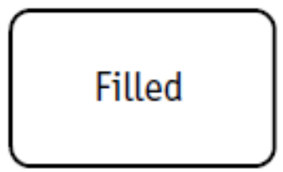
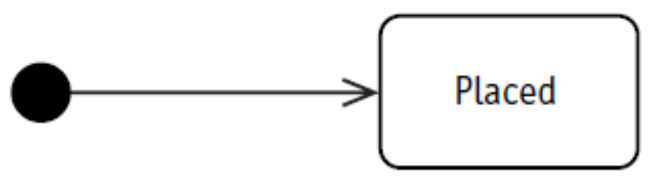
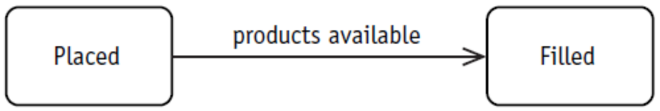
State, Initial State, Transition
State:
Initial State: The initial state indicates the state in which an object is created or constructed.
Transition:

Slide 5
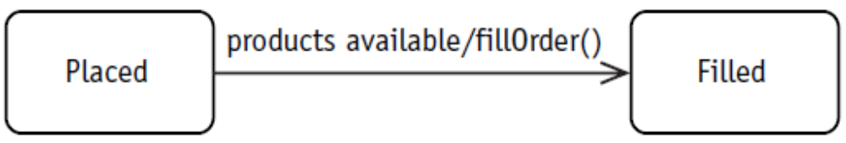
Event / Action
Event: The reason of Transition
Action: An action is associated with an event. An action is the behavior that is triggered by the event and it is the behavior that actually changes the attributes that define the state of the object. An action is an atomic task, and as such it cannot be broken into component tasks, nor can it be interrupted. There are no break points within it and, furthermore, stopping it midway would leave the object state undefined.

Slide 6
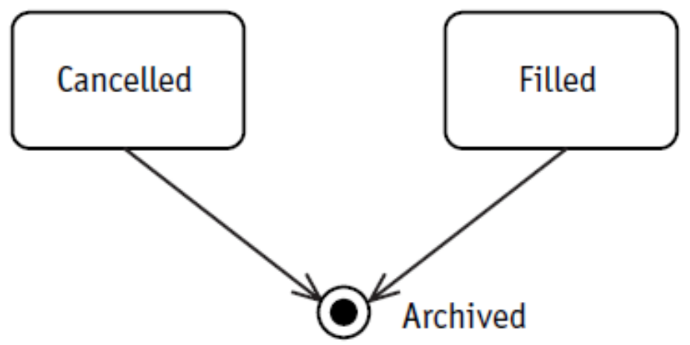
Final State
An object may reach a final state from which it may not return to an active state. In other words, you would never see an arrow going out of this state. You may still see it and it may still exist, but you can no longer alter its state. The final state may also mean that the object has actually been deleted.

Slide 7
Example
Problem Statement (Page 206)
We track current customer status to help avoid uncollectable receivables and identify customers worthy of preferred treatment. All customers are initially set up as prospects, but when they place their first order, they are considered to be active. If a customer doesn’t pay an invoice on time, he is placed on probation. If he does pay on time and has ordered more than $10,000 in the previous six months, he warrants preferred status. Preferred status may be changed only if the customer is late on two or more payments. Then he returns to active status rather than probation, giving him the benefit of the doubt based on his preferred history.

Slide 8
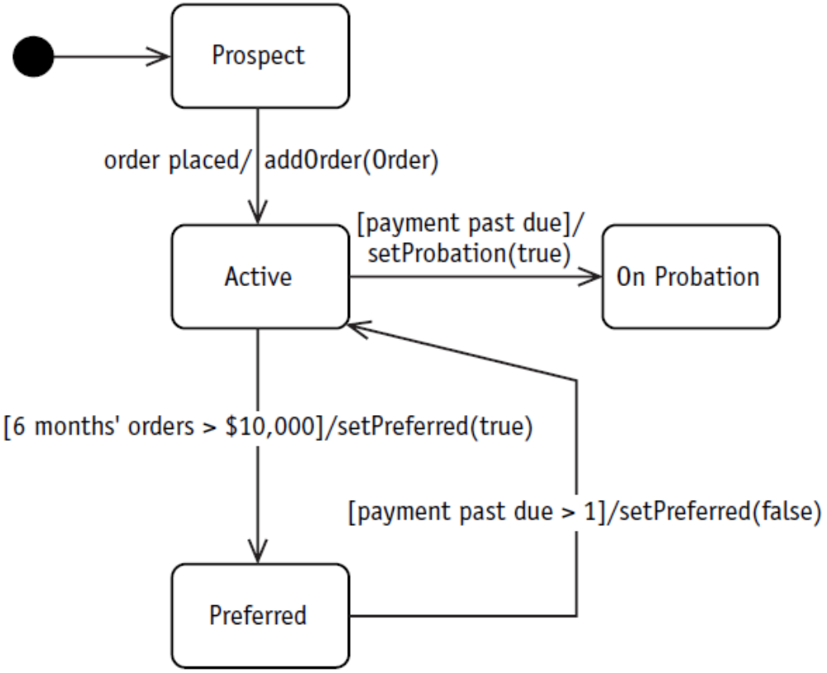
Example

Slide 9
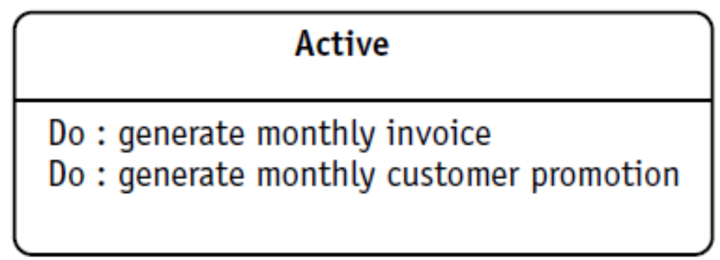
Internal Events

Slide 10
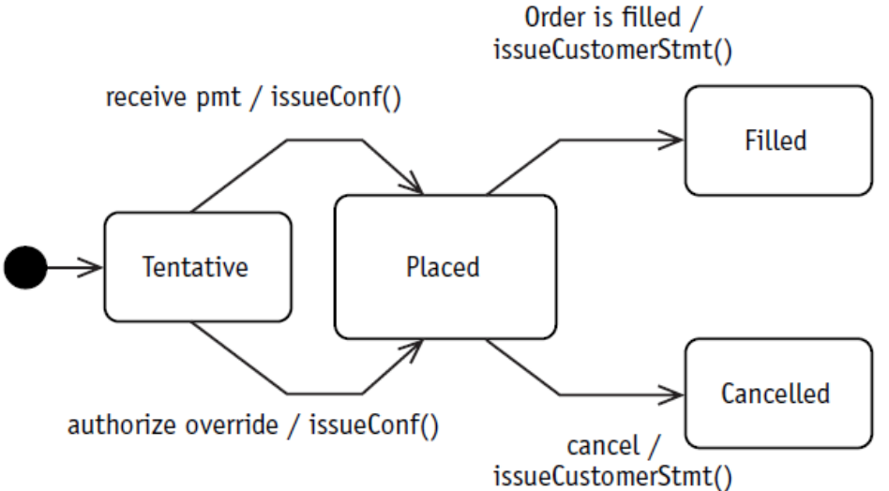
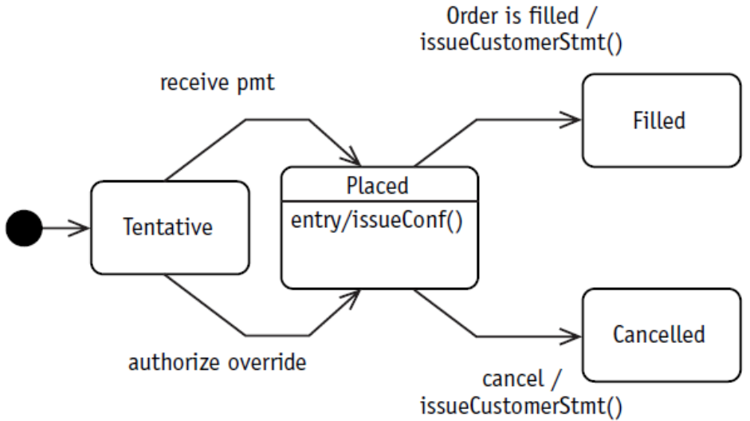
Entry Actions

Slide 11
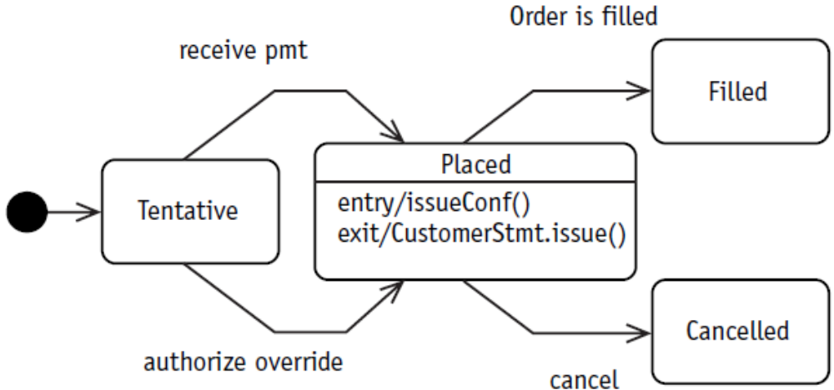
Exit Actions

Slide 12
Order of Events (Example)
When an event (E2) occurs, the order of execution runs like this:
  If an activity is in progress in the current state (A1), interrupt it (gracefully if possible).
  Execute the exit: action(s) – X2
  Execute the actions associated with the event that started it all – X3
  Execute the entry: action(s) of the new state – X4
  Execute the activity or activities of the new state – B1
StateA
StateB
E1
E2/ X3()
E3
Entry/ X1()
Do/ A1()
Exit/ X2()
Entry/ X4()
Do/ B1()
Exit/ X5()

Slide 13
Problem Statement (Page 221)
Inventory control:
Products are first entered into our system when they are ordered using a purchase order (P.O.). Each product keeps a record of the originating P.O. When the product is received, it is placed into inventory by recording the location where it is placed. When the product is received, you have to update the P.O. to indicate that you have received the product.
When a product is sold, the product tracks the order to which it belongs. When a product is sold, it is also packed for shipping and the associated shipment is recorded. When the product is shipped, you need to record the shipper and the date it was picked up. Occasionally, a product is returned. In that case, you put the product back into inventory and record the location.

Slide 14
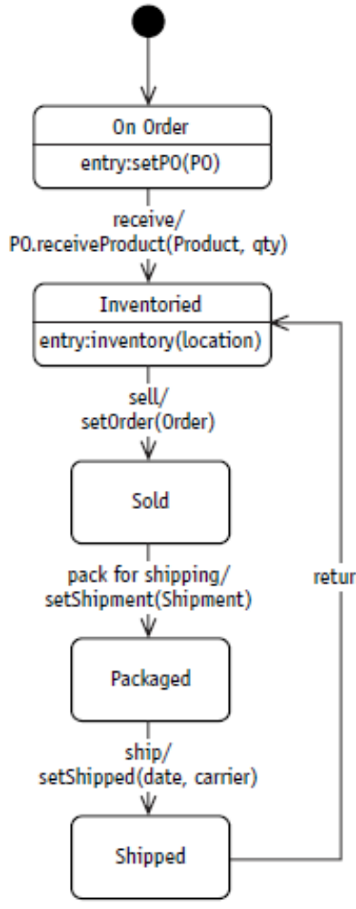
Problem Statement (Page 221)

Slide 15
Case Studies
Case 1
A course is initially created in offered state. The offered courses are then included by the students in their requests and the requests are placed for registration. Some of the requested courses are then had to be checked against other completed courses by the students as their pre requisites. If the pre-requisites are fulfilled students are added in the courses. When a course reaches the limit of its capacity the course is then closed for further student requests. On the other hand if there are not enough students requesting for a course the course is cancelled.

Slide 16
Case Studies
Case 2
Products are first entered into our system when a request for purchase for that order is issued. A purchase order is then generated for the product and recorded with that associated product. The purchase order is then sent to the vendor. When the product is received from the vendor, it is examined by the quality control department. Once the product is approved by the quality control it is placed into inventory by recording the location where it is placed. If it is not approved the product is returned to the vendor. When a customer buys a product it is included in an invoice. Sometimes, a product is returned. In that case, you put the product back into inventory and record the location. If a product is lying in the inventory for more than six months it is returned to the vendor, but this time the vendor buys back the product in a reduced price, which means the product is included in an invoice.

Slide 17
Case Studies
Case 3
In an order processing system all customers are initially set up as prospective customers, but when they place their first order, they are considered to be active. If a customer doesn’t pay an invoice on time, he is placed on notice. If he continues to keep overdue, he is given warning. If the customer doesn’t pay the dues within a month of the warning, legal actions are taken against the customer. If the customer pays after the warning, he is taken back to the system as a risky customer. Only when he has a good record of transaction for six months he is taken as regular customer. If an active customer does pay on time and has ordered more than $10,000 in the previous six months, he warrants preferred status. Preferred status may be changed only if the customer is late on two or more payments. Then he returns to active status rather than probation, giving him the benefit of the doubt based on his preferred history. Sometimes an active customer can become preferred customer if the management has special issues with the customer. The customer information is archived for good if the customer dies or if there has been no transaction with the customer for more than five years.

Slide 18
Case Studies
Case 4
A student object is created as prospective student when he submits the admission form to a university. Student information is verified against the admission requirements and if he meets all the requirements he is asked to sit for an admission test. But if the student doesn’t meet the requirements, he is rejected and the student object is deleted permanently from the system. Any student who fails in more than two subjects in the admission exam is also rejected. Students who pass in all the subjects or fail in one or two subjects are called for viva. At the viva the students who failed one or more subjects are given conditional admission with non-credit courses. Students who pass all the subjects are given regular student status. All sorts of admitted students are required to go through pre-advising to select appropriate courses for the semester. Once courses are selected students pay for the courses they have taken and become registered students of the semester. After each semester the student grade is evaluated and in case of low CGPA, the student becomes a probation student. High CGPA students are granted scholarships provided that they apply for it and fulfill the requirements. Probation students have to go through evaluation every semester and if the CGPA of the student doesn’t improve the studentship is cancelled from the university. After successful completion of the course a regular student becomes a graduate student and all the information of a graduate student is archived.

